Slide 1

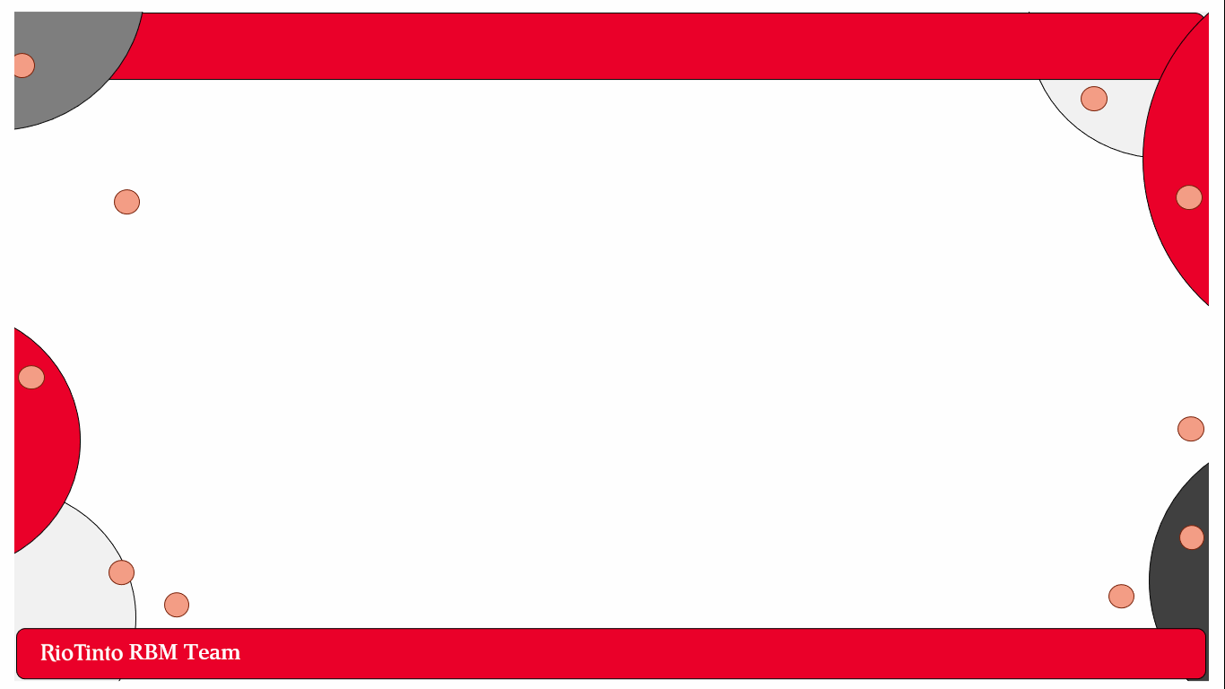


Slide 2
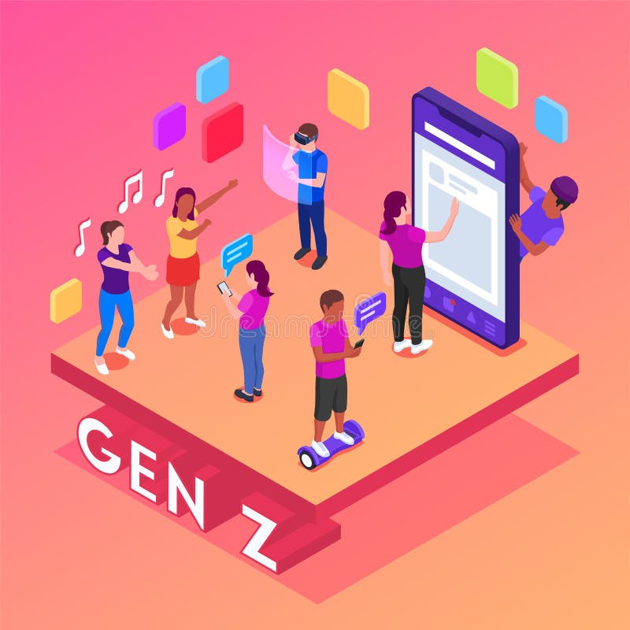


Problem Statement
Goal:
Increase employees under 35 by 10% within 5 years
Focus on attracting and retaining younger talent in a competitive job market
Challenge:
Youth demographics are crucial for growth, innovation, and adaptability
Current workforce trends:
Aging workforce and generational gap
Importance of developing a sustainable talent pipeline for RBM that ranges across South Africa

Slide 3
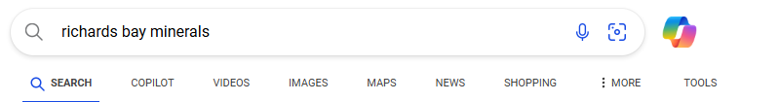
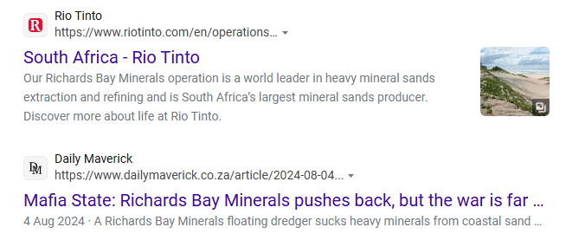
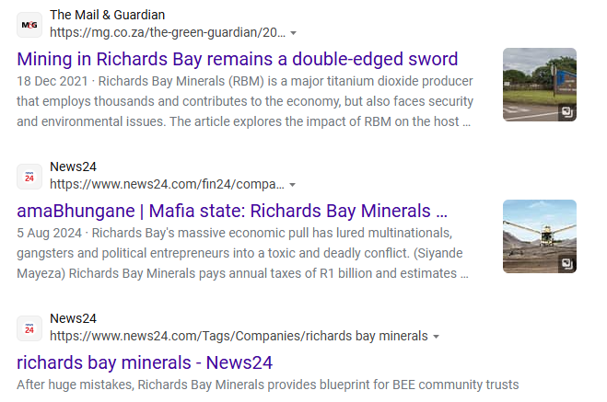
Problem Contributions 1 - Press
Official RBM Website ☺
Mafia State
Double-Edged Sword
Mafia State
After Huge Mistakes

Slide 4
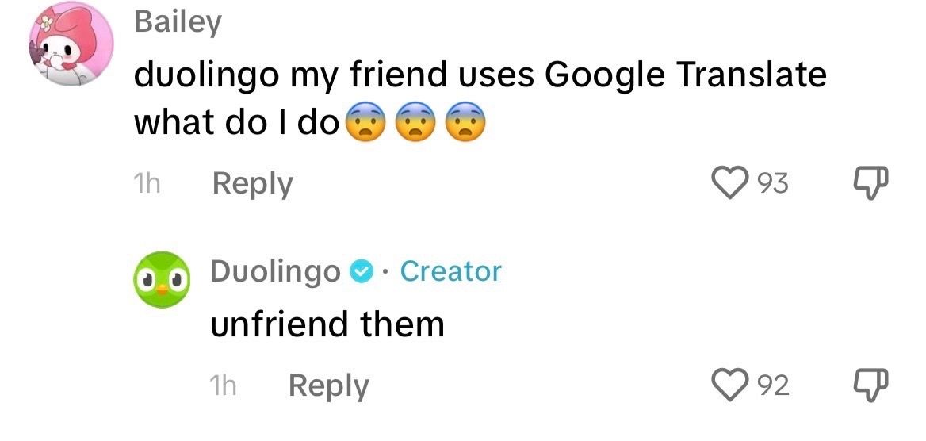
Attraction Strategies
Strategy 1 – Social Media Goal:
Social Media Goal: Expand beyond Facebook to TikTok and Instagram for better engagement; market “RBM Talks” effectively.
Strategy 2 – Website enhancement with advanced SEO:
A well-designed, user-friendly website optimized for search engines ensures the company ranks higher in search results when young job seekers research RBM

Slide 5
Retention Strategy 1
Resistance to Change:
A November 2024 article highlighted resistance to programs targeting women and marginalized groups, including leadership initiatives.
Mental Health Support:
Addressing mental health is aligned with Rio Tinto's broader initiatives like the Everyday Respect Initiative
Strategy 1
Tailored Counselling Programs
Strategy 2
Culturally Competent Counsellors
Strategy 3
On-Demand Access

Slide 6
Retention Strategy 2
Hybrid and Remote Work Options:
Working Remotely Can Increase Productivity up to 77%:
77% of those who work remotely at least a few times per month show increased productivity,
30% doing more work in less time
24% doing more work in the same period of time according to a survey by ConnectSolutions.
Solution
Carrot on a stick approach

Slide 7
Conclusion
RBM needs to attract and retain fresh talent, a gen Z radiating energy and progressive minds
BUT
Take a moment, Look around this room
WE ARE THAT TALENT, WE ARE THEIR FUTURE

